Slide 1
Load Testing -Jmeter

Slide 2
What is Non Functional Testing
Non functional testing is a type of software testing that verifies non functional aspects of the product, such as performance, stability, and usability. Whereas functional testing verifies whether or not the product does what it is supposed to, non functional testing verifies how well the product performs.
There are several different types of non functional tests. The most common ones are:
Performance Tests
Load Tests
Stress Tests
Volume Tests
Security Tests
Upgrade & Installation Tests
Recovery Tests

Slide 3
Load Testing
Load testing checks how the software behaves under both normal and peak conditions. This is done to determine how much work load the software can handle before performance is negatively affected.
You can perform load tests by running multiple applications simultaneously, subjecting a server to a high amount of traffic, or downloading a large quantity of files.
Load tests are used to ensure fast and scalable software.
This is typically done by:
Measuring response times
Identifying bottlenecks
Locating failure points

Slide 4
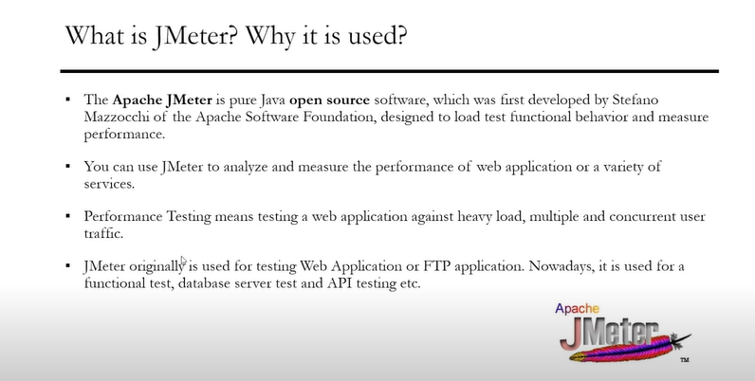
Jmeter and Advantages

Slide 5
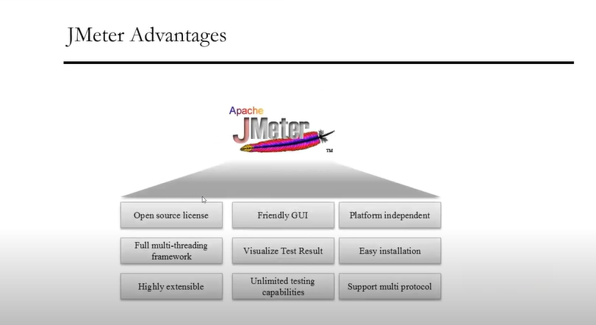
Benefits of Using Jmeter

Slide 6
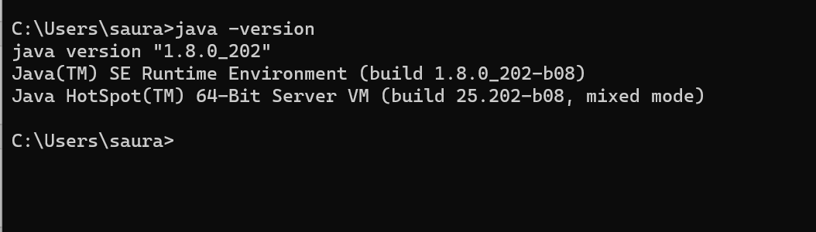
Jmeter Installation Prerequisite
Prerequisite
Java version 8 or above needs to be a part of the machine and environment variables needs to be set where Jmeter is getting installed .

Slide 7
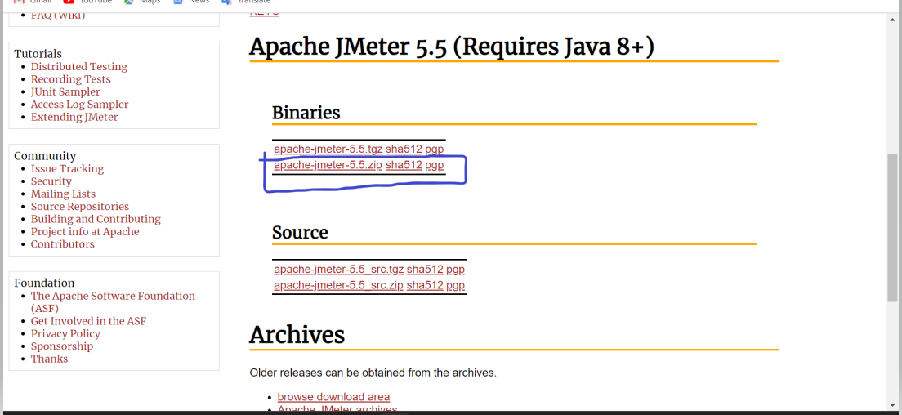
Steps of Installation
Open the URL ,
https://jmeter.apache.org/download_jmeter.cgi
And select the below option ,

Slide 8
Steps of Installation Continued

Slide 9
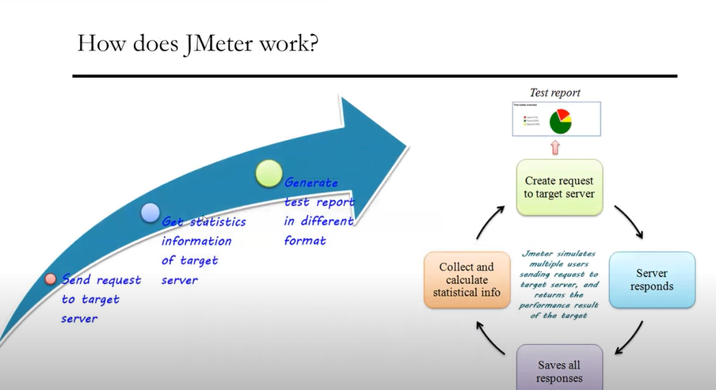
Working of Jmeter

Slide 10
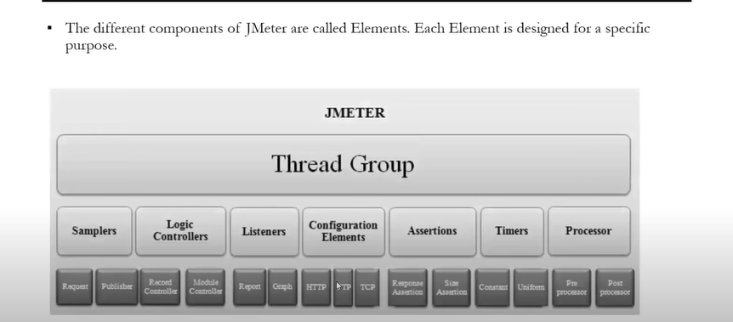
Components of Jmeter

Slide 11
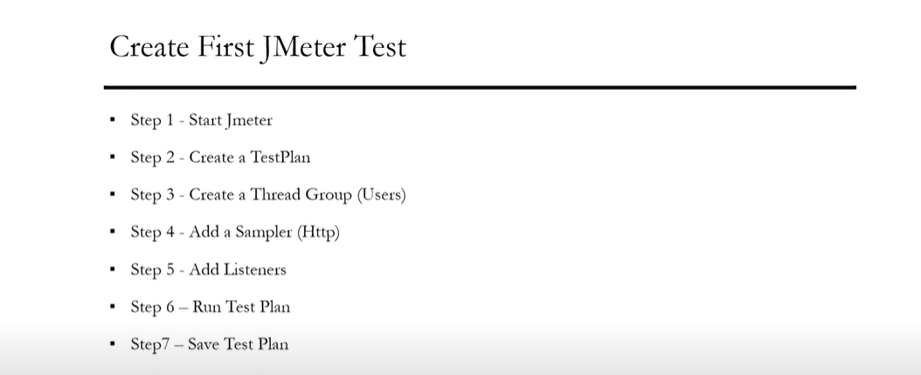
My First Jmeter Test

Slide 12
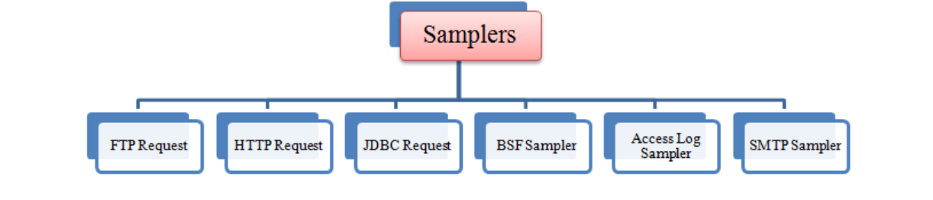
Samplers in Jmeter
The type of input which user is passing for a thread group is called as Samplers .
As we know already that JMeter supports testing HTTP, FTP, JDBC and many other protocols.
So based on these protocols the input is also passed into the thread group .

Slide 13
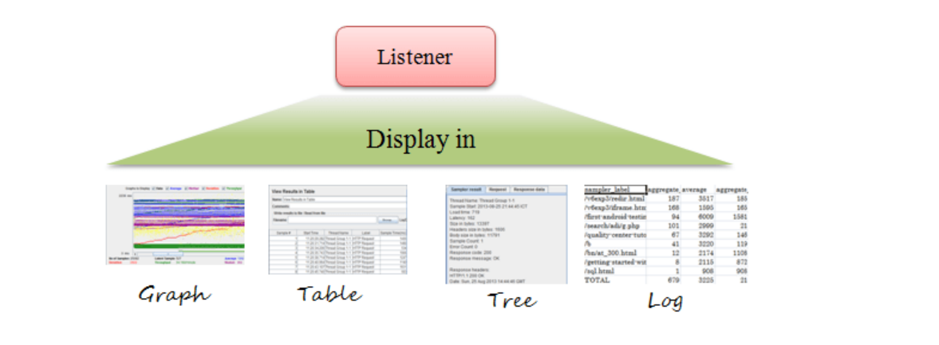
Listeners in Jmeter
Listeners: shows the results of the test execution. They can show results in a different format such as a tree, table, graph or log file.

Slide 14
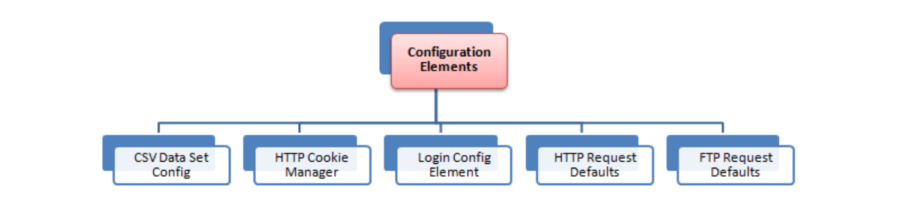
Configuration Elements
Configuration Element enable us to declare variables, so Samplers can use data through these variables. Configuration element is accessible from only inside the tree node where you defined it. Also, if a configuration element is defined inside a tree node, it will have high precedence than the same configuration element which is defined in a parent node
.

Slide 15
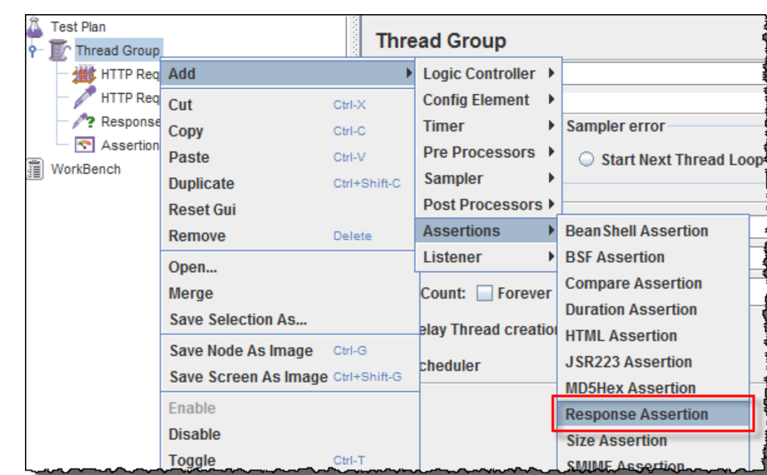
Assertions in Jmeter
Assertion help verifies that your server under test returns the expected results.
Following are some commonly used Assertion in JMeter:
Response Assertion
Duration Assertion
Size Assertion
XML Assertion
HTML Assertion
Steps to use Response Assertion

Slide 16
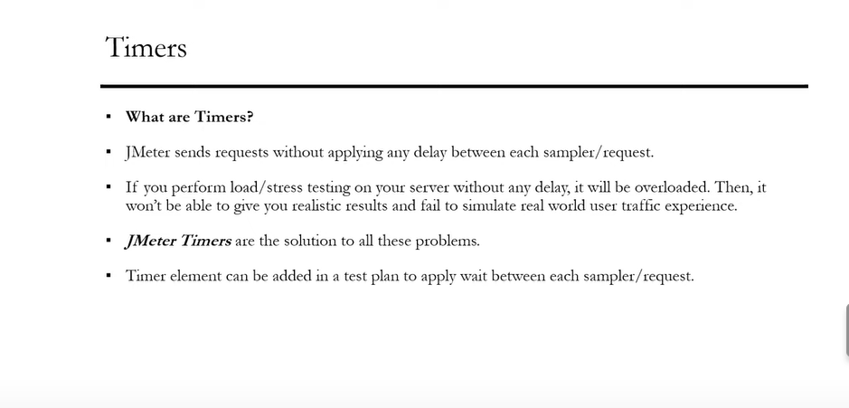
Jmeter Timers

Slide 17
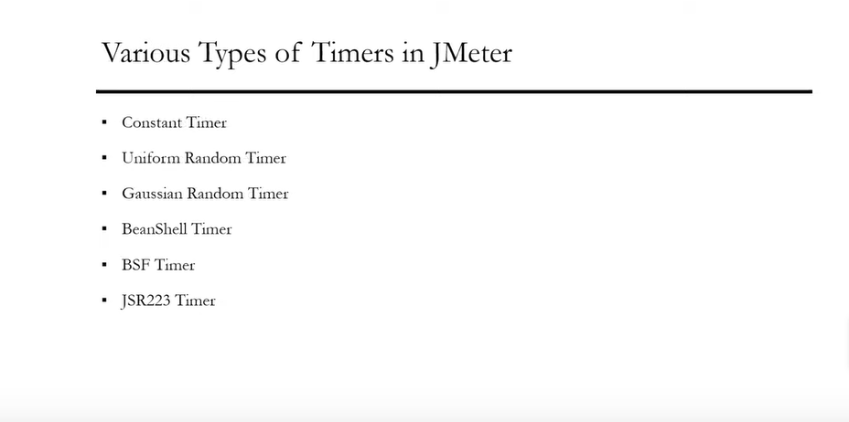
Types of Timers

Slide 18
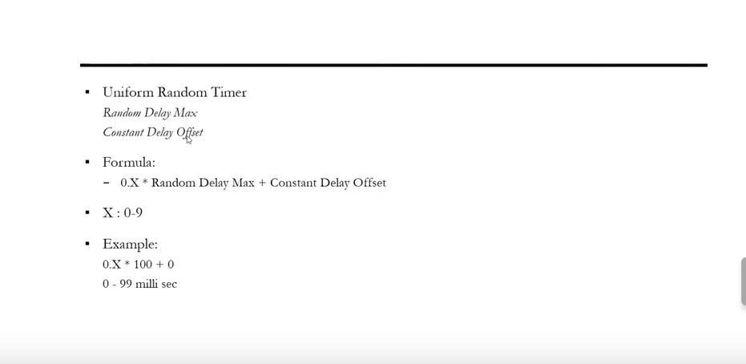
Uniform Random Timer Calculation

Slide 19
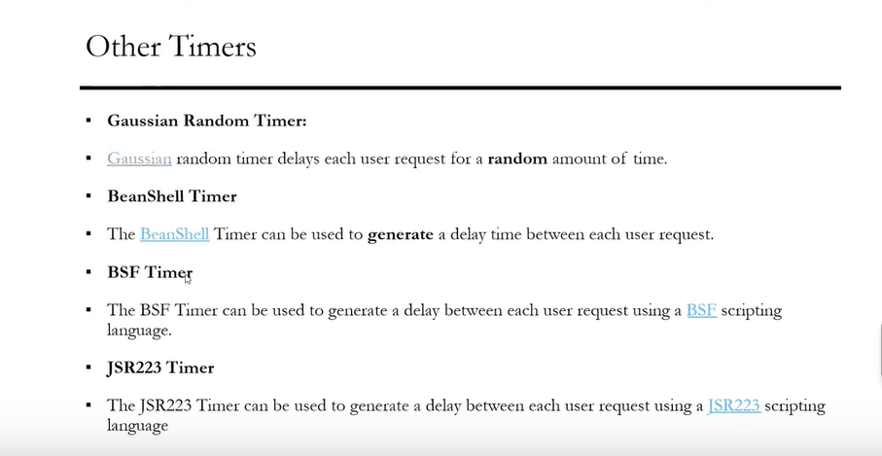
Other Timers(Not in Scope and Not used)

Slide 20

Introduction to Blazemeter
In some JMeter performance testing use cases, it is not enough just to check the time it takes for a server to render a page, produce a search result set, or create an entity. For certain application types, such as enterprise content management systems, the performance of file upload and download requests is vital.

Slide 21
Logic Controller in Jmeter
Logic Controller let you handle the order of processing Samplers/Requests in a Thread. Logic Controllers will decide “When & How” to send a request to a web server.
Critical Section Controller
ForEach Controller
If Controller
Include Controller
Interleave Controller
Loop Controller
Module controller
Once Only Controller

Slide 22
Types of Logic Controller
Random Controller
Random Order Controller
Recording Controller
Runtime Controller
Simple Controller
Switch Controller
Throughput Controller!
Transaction Controller
While Controller

Slide 23
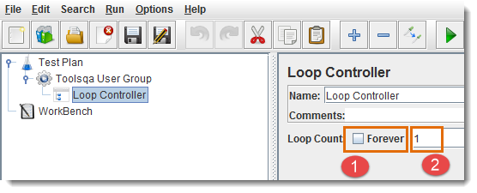
Loop Controller
Loop Controller will run the samplers/requests stored in it for the definite number of times or forever (if forever checkbox is selected).
Select Forever checkbox to run tests for infinite times
Enter loop count number to run tests for a fixed number of times

Slide 24
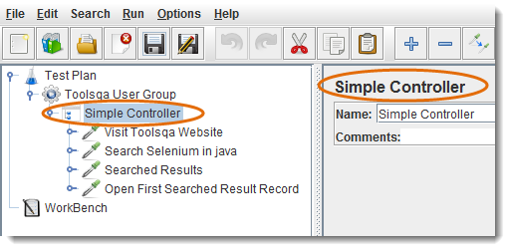
Simple Controller
Simple Controller helps in organizing and storing the Samplers and other Logic Controllers. It doesn’t offer any other functionality like other controllers.

Slide 25
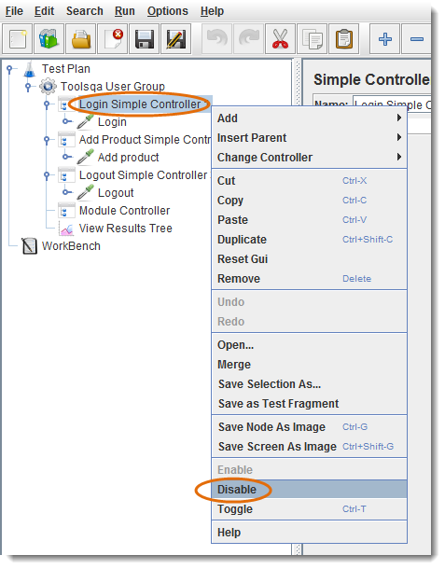
Module Controller
Module controller adds modularity to the JMeter Test Plan. Normally we construct test plan consists of small units of functionality like Login, Add Product, Logout. The functionality can be stored inside Controllers as modules e.g. “Simple Controller” can be used to store each module inside it. In order to run modules by only Module con
troller, don’t forget to disable Simple Controller.

Slide 26
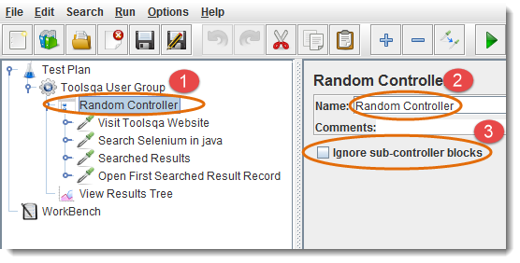
Random Controller
Random Controller is similar to “Interleave Controller” except that it makes samplers/requests to run in random order in each loop. For Example, you have defined “4” Http requests under “Random Controller”, then these requests will be sent in random order and their order of execution will be decided on rum-time.

Slide 27
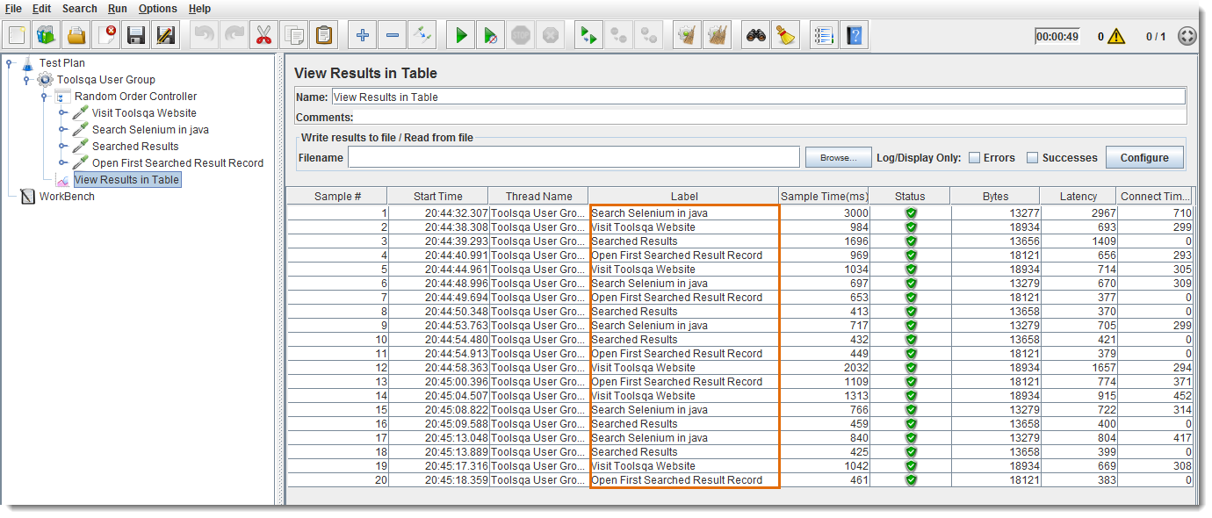
Random Order Controller
Random Order controller is similar to “Simple Controller”, it will make all samplers to run in random order in each thread loop.
Let’s consider an example of Random Order Controller, where Thread Group contains “Number of Threads” to “1”, “Loop Count” to 5, and a total of “4” Samplers (Http requests). A total of 1 * 5 * 4 = “20” requests will be sent to the web server under test. The order of execution will be random, as you can see in the following figure:

Slide 28
Configuration Elements
Configuration Element enable us to declare variables, so Samplers can use data through these variables. Configuration element is accessible from only inside the tree node where you defined it. Also, if a configuration element is defined inside a tree node, it will have high precedence than the same configuration element which is defined in a parent node.
There are different types of configuration elements
Counter
CSV Data Set Config
DNS Cache Manager
FTP Request Defaults
HTTP Authorization Manager
HTTP Cache Manager
HTTP Cookie Manager
HTTP Header Manager
HTTP Request Defaults
Java Request Defaults

Slide 29
Configuration Elements Continued
JDBC Connection Configuration
Keystore Configuration
LDAP Extended Request Defaults
LDAP Request Defaults
Login Config Element
Random Variable
Simple Config Element
TCP Sampler Config
User Defined Variables

Slide 30
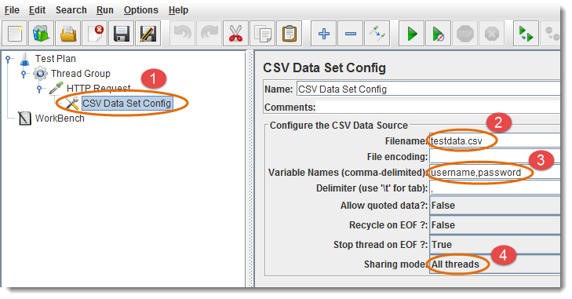
CSV Data Set Config
CSV Data Set Config element is used to read data from a text or CSV format file. For Example, If you need to perform load test of login scenario with 100 unique users. Prepare the data in CSV file with 100 user records with username and password, and you can use this file data in every thread through variables in your requests/samplers by using this configuration element

Slide 31
Set of Config Elements in Jmeter
Add “CSV Data Set Config” Element where it will be used
You can give file path or filename of your text/CSV file. If file is stored in the same location as your “Test Plan” is, then give only filename.
Give variable names for text/CSV file column values, use these variable as “$username” / “$password” in samplers
Select sharing mode

Slide 32
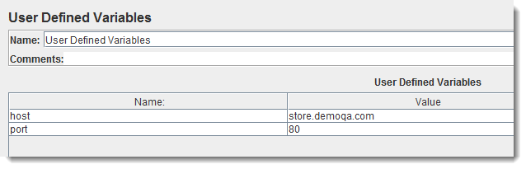
User Defined Variables
User Defined Variables Element let us use default variables and values in the test plan. If you need to use UDV in only one Sampler, then define it under that Sampler. If you need to use UDV in multiple parts, then define it at the start of

Slide 33
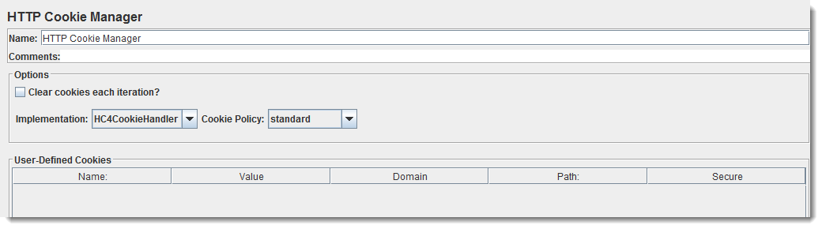
HTTP Cookie Manager
HTTP Cookie Manager is used to store cookies which targeted server sends in the response of your Http request. The saved cookies can be used in other samplers/requests of the Test Plan.
You can also add User Defined Cookies, these cookies will be shared to all the Threads.
Cookies can be seen using the “View Results Tree” Listener.
Such Cookies usually have Expiration time far in the future.

